Slide 1
DATA ANALYSIS AND VISUALIZATION ON WORLD POPULATION ANALYSIS
SONALI.R
CRANES VARSITY

Slide 2
CONTENTS
Introduction to Data Analysis
Data Collection and Cleaning
Visualization Techniques
Importance of Data Analysis and Visualization
Exploratory Analysis In Data
Statistical Analysis In Data
Trends In Data Visualization
Analyzed Data Set of World Population
Conclusion

Slide 3


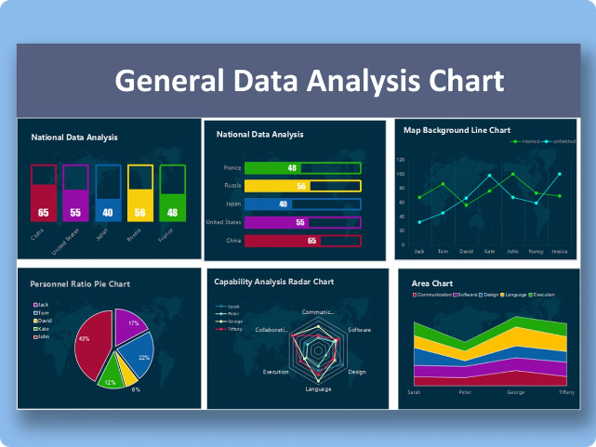
Data Analysis: A Powerful Tool for Understanding the World
Data analysis is a process of examining raw data to extract meaningful insights and patterns. It involves collecting, cleaning, transforming, and modeling data to answer questions, solve problems, and make informed decisions.

Slide 4


Data Collection and Data Cleaning
1
Collecting Data
2
Cleaning Data
Data can be collected from various sources, including surveys, databases, web scraping, and APIs. The quality of the data collected is crucial for the accuracy of subsequent analysis.
Cleaning data involves identifying and correcting errors, inconsistencies, and missing values. This step ensures the reliability and validity of the analysis.
3
Data Transformation
4
Data Storage
Transforming data involves changing the format or structure of the data, such as scaling, encoding, or aggregation. This step prepares the data for analysis and visualization.
Storing data in a structured and accessible way is essential for efficient analysis. Databases, data warehouses, and cloud storage solutions provide robust storage options.

Slide 5

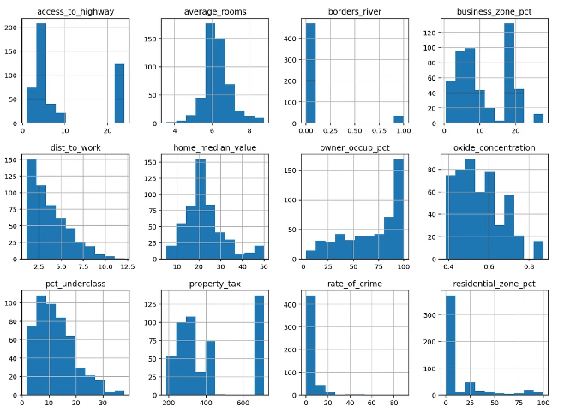
Exploratory Data Analysis
1
Data Exploration
The goal is to understand the basic characteristics of the data, including its distribution, central tendencies, and outliers.
2
Data Visualization
Using graphs and charts to gain insights into data patterns, trends, and relationships.
3
Hypothesis Generation
Based on observations, formulating testable hypotheses about the data.
4
Feature Selection
Identifying the most relevant variables for further analysis and modeling.

Slide 6
Statistical Modeling
Regression Models
Classification Models
Clustering Models
Predicting a dependent variable based on independent variables. Examples include linear regression, logistic regression, and polynomial regression.
Categorizing data points into predefined classes. Examples include decision trees, support vector machines, and k-nearest neighbors.
Grouping data points based on similarity. Examples include k-means clustering, hierarchical clustering, and density-based clustering.

Slide 7
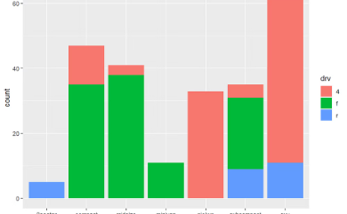
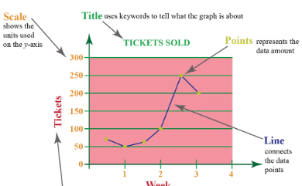
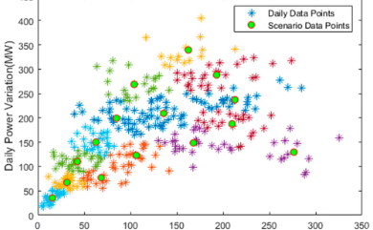
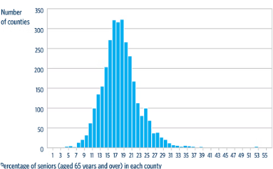
Visualization Techniques
Bar Charts
Line Charts
Scatter Plots
Histograms
Comparing categorical data.
Showing trends over time.
Representing relationships between two variables.
Visualizing the distribution of numerical data.

Slide 8





Predictive Analytics
Data Preparation
Cleaning, transforming, and preparing data for modeling.
Model Selection
Choosing the appropriate statistical model based on the data and the goal of the analysis.
Model Training
Training the model on a subset of data to learn patterns and relationships.
Model Evaluation
Assessing the accuracy and performance of the model using various metrics.
Model Deployment
Deploying the model to make predictions on new data.

Slide 9

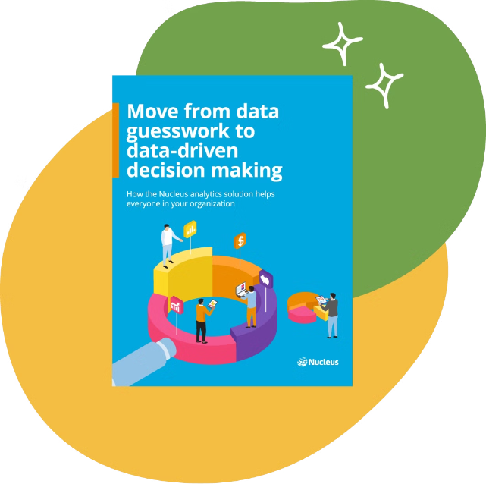
Importance of Data Analysis and Visualization
Data analysis is essential for making informed decisions in various fields, including business, healthcare, finance, and research. Visualizing data effectively allows for clearer communication of insights, enabling collaboration and understanding across different stakeholders.

Slide 10

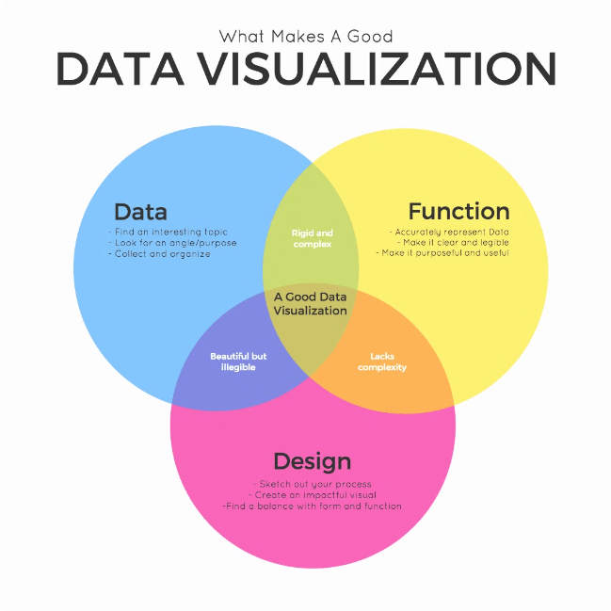
Importance of Data Analysis and Visualization
Informed Decision Making
Problem Solving
Data analysis provides insights that support evidence-based decisions, leading to better outcomes.
By uncovering patterns and trends, data analysis helps identify and address problems effectively.
Innovation and Discovery
Improved Efficiency
Data analysis can lead to new insights, breakthroughs, and innovations in various fields.
By automating tasks and identifying areas for optimization, data analysis enhances efficiency and productivity.

Slide 11


Ethical Considerations in Data Analysis
Privacy
Protecting sensitive data and ensuring confidentiality.
Bias
Minimizing bias in data collection, analysis, and interpretation.
Transparency
Being transparent about data sources, methods, and results.
Fairness
Ensuring that data analysis and its applications are fair and equitable.

Slide 12






Trends in Data Analysis
Artificial Intelligence (AI)
Big Data
Cloud Computing
Data Science
AI-powered algorithms are transforming data analysis, enabling more sophisticated insights and predictions.
The increasing volume, velocity, and variety of data require advanced tools and techniques for analysis.
Cloud-based data storage and analytics platforms provide scalability, flexibility, and cost-effectiveness.
Data science combines statistical methods, computer science, and domain expertise for solving complex problems using data.

Slide 13
Functions and Steps Used For Analysis
Important Data Set
Slicing
Shape
Adding Columns
Deleting Columns
Find Sum, Max, Min
Datetime
Subsets
Joins
Groupby

Slide 14
Conclusion
The field of data visualization is rapidly evolving, driven by advancements in technology and growing demands for accessible, accurate, and actionable insights. Trends such as interactive dashboards, AI integration, and data storytelling are making it easier to explore, understand, and communicate complex data. As visualizations become more sophisticated, there's a strong focus on accessibility, ethical representation, and user-friendly design, ensuring that insights are not only powerful but also widely available and responsibly communicated. Staying informed about these trends is crucial for leveraging data visualization to its fullest potential in decision-making and strategic planning to do.

Slide 15
THANK
YOU

